Slide 1
TrAF-Cloud WP5 – Proof of Concept 1
Current state of the PoC, and
Next steps
2021-03-08
Niklas and Milin

Slide 2
Outline
Overview TrAF-Cloud Project targets and TrAF-Cloud PoC plans
The first PoC, target and design
PoC 1 demo and rundown
Discussion, PoC 2 targets
Conclusion

Slide 3
Overview TrAF-Cloud Project targets and TrAF-Cloud PoC plans

Slide 4
Project Targets Overview From Proposal & kvalitetsgransking@FFI
TrAF-Cloud Goals
Effect Goals
Faster deployment and integration of new functionality;
The possibility of collecting and sharing large scale of data;
Access to computational resources not available on-board;
Creation of functionality that spans multiple vehicles;
Highly scalable data storage, processing and analytics capabilities.
”
Demonstrate and evaluate the viability of a business-oriented ecosystem for transport cloud services
Demonstrator Deliveries
To fully utilize combined cloud and truck eco-system, they must follow the same design patterns
Make vehicle and cloud part of the same architecture
Seamless allocation of functionality
Demonstrate a reference platform that integrates on-board and off-board functionality based on selected use cases
Current truck architecture is signal-based and static
Migrate to SoA, adhere to cloud architectural principles
PoC focus

Slide 5
PoC—Focus and Iterations
Demonstrate a reference platform that integrates on-board and off-board functionality based on a selected use cases
Demonstrator 1 D5.2 (MS3, 21Q2) – Targets
Establish basic functionality; integrate onboard and offboard communication patterns
Show that onboard funtionality can be invoked from offboard service
Show how to leverage SoA principles of Adaptive AUTOSAR
Show how to leverage MDA-techniques for faster development and deployment
Next demonstrators
Demonstrator 2 (D5.3, MS4 21Q4); targets to be disussed after demo
Innovation challenge (D5.4, MS5 22Q2); may not be feasible, plan for additional demo iteration?
Final demonstrator (D5.5, MS6 22Q4)

Slide 6
The first PoC, target and design

Slide 7
PoC—Premises
Three deployment environments
Seamless deployment…
…requires architectural support
ECU software
Embedded software, distributed platform, ECUs running (classic and adaptive) AUTOSAR, embedded Linux
Limited memory and compute
Hard real-time, safety critical
Long dev. & depl. cycles
Cloud environment
“Cloud software”
Very scalable memory and compute resources
Multiple vehicles accessible
Short dev. & depl. cycles
Edge Node
“Cloud Software”
Limited memory and compute
Short dev. & depl. cycles
Onboard
Offboard
Communication patterns
Request – Response
Off-board requests invokation of an onboard service, receives a response
On-board Edge requests invokation of an onboard service, receives a response
On-board ECU S/W requests invokation of an onboard service, receives a response
…
Publish – Subscribe
Onboard/Edge/offboard service publishes event notifications
Subscribing Onboard/Edge/offboard service subscribes to notification
PoC 1

Slide 8
Example Req-resp cases
E.g, periodically check current vehicle speed, or request headway lights
Offboard service is implemented in suitable language (e.g. Python, TypeScript, C++, Java, etc)
Offboard environment provide native APIs to truck functionality
TrAF-Cloud architecture responsible for
Generating APIs for range of languages → Structure and format of Platform Boundary objects consistent
Middleware to invoke function on vehicle
Onboard
Offboard
Request
PoC 1
Response
E.g. process diagnostics data; if cloud connectivity -> send/stream data and do processing offboard
Offboard service offered to ECU software in native format (e.g. SOME/IP)
For onboard funtionality, offboard service appears as just another implementation @service discovery
TrAF-Cloud architecture responsible for
Offering available Edge and Offboard services to ECU software
Managing service registry
Managing QoS and routing (black- / brown-out)
Onboard
Offboard
Request
Response

Slide 9
PoC 1 demo and rundown

Slide 10
onboard
PoC 1 is:
API gateway (implemented)
Offboard service proxy (code generated)
Utilizing AWS IoT Core for communication
offboard
Application X
<<calls>>
ECU software
VGCS
Interface (API)
Interface (API)
Service/Endpoint exposed
(Heawayill.SetLightDistribution)
Service/Endpoint proxy exposed
(Heawayill.SetLightDistribution)
Implementation
<<calls>>
AWS IoT Core (middleware)
Edge node (component)
API Gateway
(middleware)

Slide 11
Onboard platform
Offboard platform
Application X
ECU software
Interface (API)
VAS / Functional
Service/Endpoint exposed
(Heawayill.SetLightDistribution)
VGCS
Implementation
Interface (API)
Service/Endpoint proxy exposed
(Heawayill.SetLightDistribution)
Edge node / platform
Middleware
TrAF-Cloud API Gateway
Adaptive AUTOSAR
Truck Gateway
Cloud Gateway
AWS IoT Core
SOME/IP
Socket Server
Socket Client
MQTT Client
MQTT Broker
Network

Slide 12
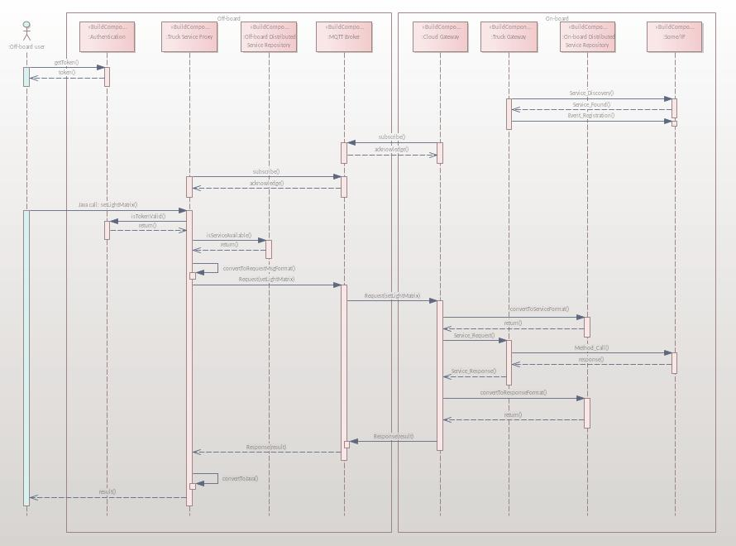
PoC Example call
PoC implementation
Application X
Authentication
Truck service Proxy
Service Registry
MQTT Broker
Cloud Gateway
Truck Gateway
Service Registry
Some/IP

Slide 13
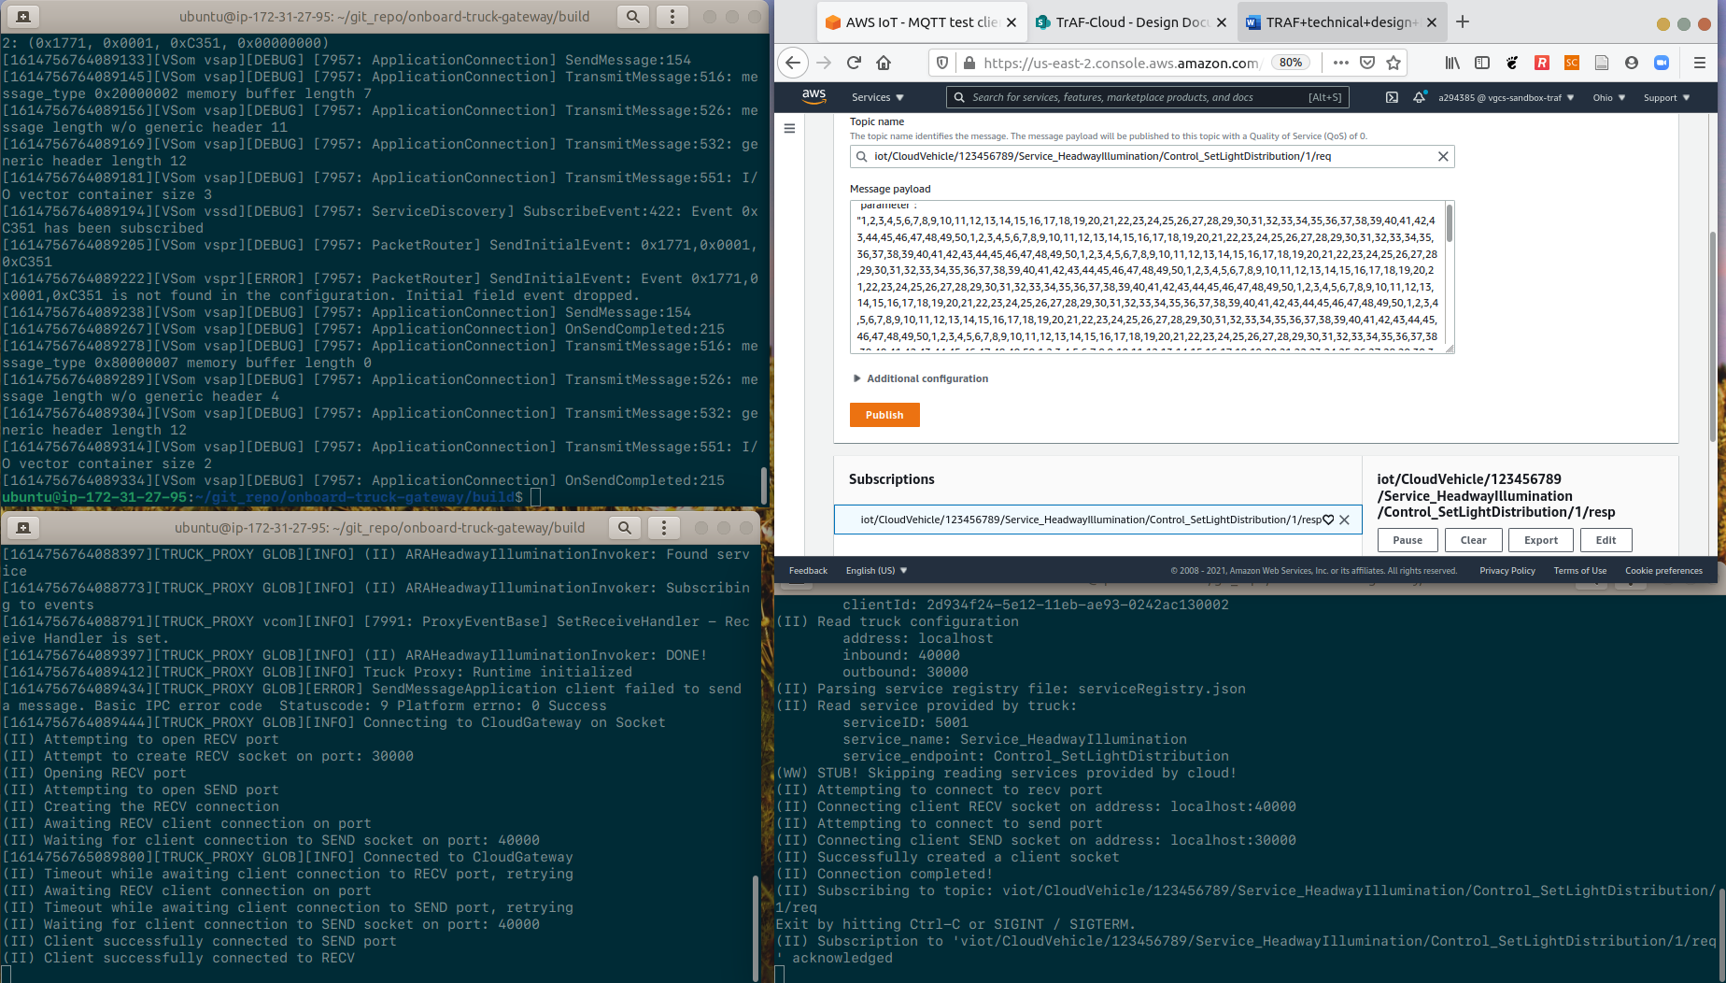
PoC 1 – Demo
ECU Software
Offboard
Some/IP
MQTT
TruckGateway
UDP Socket
CloudGateway
API Gateway (Edge)

Slide 14
Code generation
<<document>>
arXML
Interface description in Adaptive AUTOSAR
Specified in an XML-format
Mainly for deployment and dependency management
Contains information to generate API (C++)
Is part of onboard development workflow (a common well-defined asset)
Useful for TrAF-Cloud
To generate offboard API in various languages (demonstrated)!
To generate API gateway components (investigated, but not demonstrated)
To specify offboard services to be consumed onboard (in theory)

Slide 15
onboard
Code generation PoC 1
offboard
App B
App A
<<calls>>
<<document>>
arXML
<<calls>>
Interface (API)
<<specifies>>
<<specifies>>
Interface (API)
Service/Endpoint to be exposed
Eg. Heawayill.SetLightMatrix
Service/Endpoint to be exposed
Eg. Heawayill.SetLightMatrix
Implementation
<<generate>>
<<calls>>
<<specifies>>
API-gateway
<<code>>
Available services
<<code>>
Available services
<<code>>
Available services
<<document>>
Exposed services
<<deploy>>
<<configures>>
TruckGW
CloudGW
<<calls>>
ServiceRepo
<<calls>>
ServiceRepo
<<Bold>> -> design-time
<<italics>> -> run-time

Slide 16
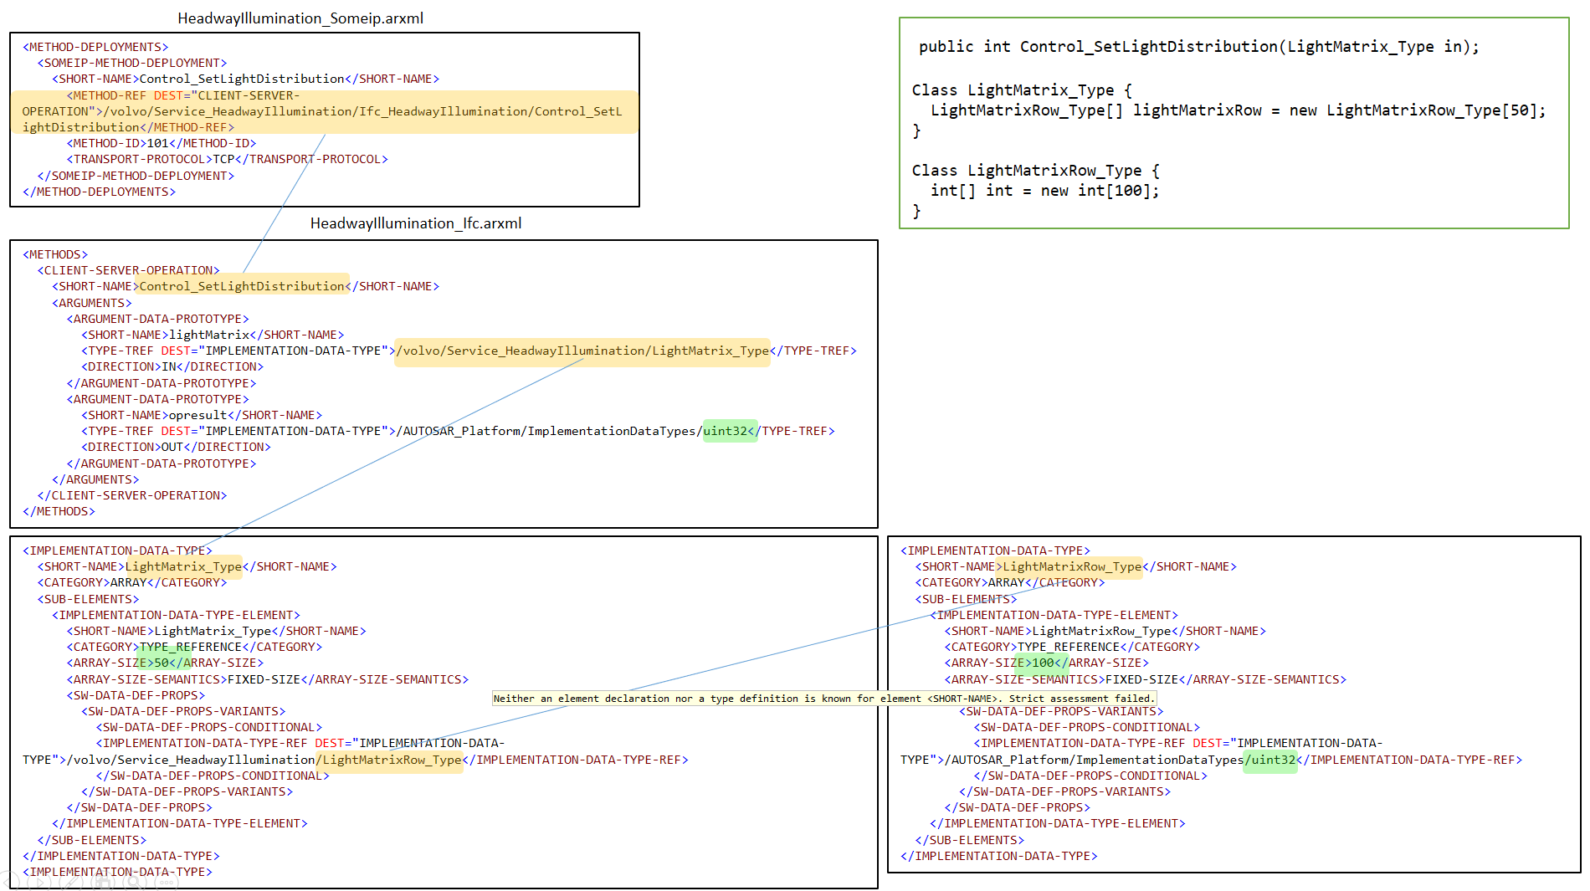
Code generation

Slide 17
Conclusion

Slide 18
Summary
Make vehicle and cloud part of the same architecture
“Vehicle and Cloud part of the same architecture” & “Creation of functionality that spans multiple vehicles”
Middleware to expose vehicle services…
…native to a range of typical cloud languages/environments
“Faster deployment and integration of new functionality”
Code generation from common asset → middleware can be auto-generated → Extensibility with minimum of manual effort
Demonstrates possiblity to integrate in develoment tool-chains
Effect Goals
Faster deployment and integration of new functionality;
The possibility of collecting and sharing large scale of data;
Access to computational resources not available on-board;
Creation of functionality that spans multiple vehicles;
Highly scalable data storage, processing and analytics capabilities.

Slide 19
Challenges not addressed (yet) Non-exhaustive! Many more can/should be listed!
Middleware
Authentication and Authorization
How to manage identities onboard?
How to manage and enfore access control onboard?
Service repository management
How to manage available services (on- and offboard); how to bring up and down services?
Functional architecture
Request arbitration
Requests to an onboard service can now come from multiple sources (edge and offboard); how to arbitrate?
Offboard API design
The set and structure of onboard service APIs (part of VAS-FuRA?)
QoS / “Elasticity”(?)
How to handle blackout, brownout? What middleware support is required?

Slide 20
Demonstrator 2 (21Q4)
What are the targets for demonstrator 2?
Proposal 1: “Seamless deployment of services”
Offboard implementation accessible from onboard
I.e. transparently offer an offboard implemetation of a known onboard service
Example: Diagnostics?
Effect goals: ii, iii, v
Proposal 2: ?
What has potential to have impact on AB Volvo?
What will raise interest?
Effect Goals
Faster deployment and integration of new functionality;
The possibility of collecting and sharing large scale of data;
Access to computational resources not available on-board;
Creation of functionality that spans multiple vehicles;
Highly scalable data storage, processing and analytics capabilities.

Slide 21
Onboard platform
Offboard platform
Application X
ECU software
Interface (API)
VAS / Functional
Service/Endpoint exposed
(Heawayill.SetLightDistribution)
VGCS
Implementation
Interface (API)
Service/Endpoint proxy exposed
(Heawayill.SetLightDistribution)
Edge node / platform
Middleware
TrAF-Cloud API Gateway
Focus can now be on the functional architecture (i.e. VAS-FuRA) with cloud as a deployment environment.
With PoC 2 in place, we have the basic means to quickly test setups…
Adaptive AUTOSAR
Truck Gateway
Cloud Gateway
AWS IoT Core
SOME/IP
Socket Server
Socket Client
MQTT Client
MQTT Broker
Network

